Slide 1
Introduction to Data Science & Business Understanding
Chapter 1

Slide 2
Objectives
At the end of this chapter, students will be able to
  Define the term: Data Science
  Discuss basic characteristics of the Data Science Projects
  Discuss the steps in the Data Science Project
  Describe how business understanding is important in any data science project
  Define the problem statement and objectives

Slide 3
What is Data Science?
Data science is one of the most exciting emerging fields.
Data science is a term given to the practice of analyzing raw data to discover any hidden patterns.
Various applications and tools such as machine learning and sophisticated algorithms are all used in this process.
It can be applied to both structured and unstructured data.
Data science is a more in-depth, detailed way of analyzing data than data analytics.

Slide 4
Data Science-Types of Analysis
Data scientists employ exploratory analysis of current or past data using sophisticated tools to uncover new insights and predict future events.
Diagnostic analytics are used for discovery or to determine what had happened in the past.
This makes it useful for predictive analytics. These are models that predict the possibility of a certain event occurring in the future.
It is also useful for prescriptive analytics, intelligent models capable of making their own decisions and learning within dynamic parameters.

Slide 5
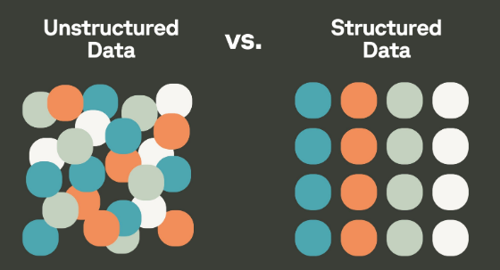
Why do we need Data Science?
Until recently data was structured and small in size. It was able to be analyzed either manually or with the use of simple tools and algorithms.
Today due to technological developments more and more data are produced. This is often semi-structured, or completely unstructured. (80% of data is unstructured)
Handling, processing and analyzing huge amount of heterogeneous data require some complex, powerful, and efficient algorithms and technology termed as Data Science.
With the help of data science, we can convert the massive amount of raw and unstructured data into meaningful insights

Slide 6

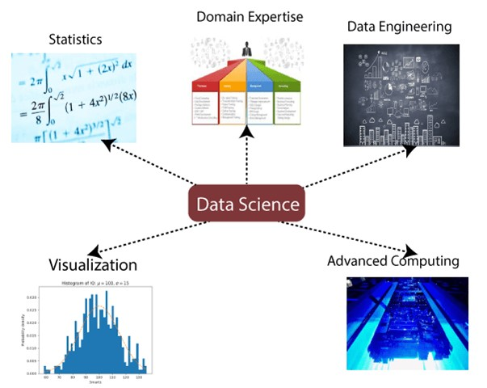
Data Science Components
Statistics: Helps us analyze data, find patterns, averages, trends, and make predictions.
Domain Expertise: Knowledge of the field where the data comes from (banking, healthcare, retail, education, etc.).
Without domain knowledge, results may be meaningless.
Data Engineering: Involves collecting, storing, cleaning, and preparing data so it can be analyzed.
Visualization: Converts data into graphs and charts so results are easy to understand.
Advanced Computing: Uses powerful computers and algorithms to handle large datasets.

Slide 7
Data Science Process
Step 1: Frame the problem
The first thing you have to do before you solve a problem is to define exactly what it is.
You need to be able to translate data questions into something actionable.
Step 2: Collect the raw data needed for your problem
Once you’ve defined the problem, you’ll need data to give you the insights needed to turn the problem around with a solution. Find the sources and get the data.

Slide 8
Data Science Process
Step 3: Process the data for analysis
Data can be quite messy, especially if it hasn’t been well-maintained.
Check for Following Errors
  Missing values, for example some of the student marks missing.
  Corrupted values, such as invalid entries.
  Time zone differences, perhaps your database doesn’t take into account the different time zones of your users.
  Date range errors, perhaps you’ll have dates that makes no sense, such as date registered from before sales started.

Slide 9
Data Science Process
Step 4: Exploratory data analysis
There are two main goals to exploratory data analysis.
The first is you want to know if the data that you have is suitable for answering the question that you have.
  Is there enough data?
  Are there too many missing values?
  Am I missing certain variables or do I need to collect more data to get those variables, etc.?
The second goal of EDA is to start to develop a sketch of the solution.
  Apply your statistical, mathematical and technological knowledge

Slide 10
Data Science Process
Step 5: Formal modeling
The formal modeling phase is the way to specifically write down what questions you’re asking and what parameters you’re trying to estimate.
Challenging your model and developing a formal framework is really important to making sure that you can develop robust evidence for answering your question.
And It helps to examine their sensitivity to different assumptions.

Slide 11
Data Science Process
Step 6: Interpretation
You’ve probably done many different analyses, you probably fit many different models. And so you have many different bits of information to think about.
Part of the challenge of the interpretation phase is to assemble all of the information and weigh each of the different pieces of evidence.
You know which pieces are more reliable, which are more uncertain than others, and which more important than others to get a sense of the totality of evidence with respect to answering the question.

Slide 12
Data Science Process
Step 7 : Communication
The last phase is the communication phase.
Any data science project that is successful will want to communicate its findings to some sort of audience.
That audience may be internal to your organization, it may be external, it may be to a large audience or even just a few people.

Slide 13
Data Science Process - Summarized
Define/Frame the Problem
Precisely define the problem
Collect Data
Mostly from various sources, Raw
Preprocess
the Data
Remove impurities like Missing values, corrupted values, noise, etc
Perform EDA
Formal Modeling
Interpret the results
Communicate
Explore the data to understand it better to check suitability and sketching the solution
Create evidences for answering the question effectively
Assemble and put together the evidences
Communicate findings to the stakeholders effectively
Very important
Should be relevant

Slide 14
Applications of Data Science
Image Recognition and Speech Recognition:
  Automatic image tagging suggestion on Facebook uses image recognition algorithm.
  “Ok Google, Siri, Cortana", etc., and these devices respond as per voice control which uses speech recognition algorithm.
Transport:
  Transport industries also using data science technology to create self-driving cars.
Healthcare:
  Data science is being used for tumor detection, drug discovery, medical image analysis, virtual medical bots, etc.

Slide 15
Applications of Data Science
Recommendation Systems:
  Many companies like Amazon, Netflix, Google Play, etc., are using personalized recommendations (suggestions for similar products).
Risk Detection:
  Most of the finance companies/ banks are using data science to avoid risk and any type of losses with an increase in customer satisfaction.
Crime Analysis:
  Data Analytics can be used for crime analysis based on the area of frequent crime, historical pattern (predictive Policing) also used to predict civil unrest in cities based on social media posts.

Slide 16
Applications of Data Science
Sentiment Analysis:
  Sentiment analysis helps to rapidly read about products and services on different social platforms
Churn Prediction:
  Predicting which customers will churn will help a company to retain their existing customers by analyzing historical transactions
Data Analysis in Education:
  Each student can be tracked by showing how much he is reading the book, what pages he skips, how much he highlights, and whether he is taking notes etc.

Slide 17
Data Science Tools
Following are some of the tools required for data science:
Data Analysis tools: R, Python, SAS, MATLAB, Excel, RapidMiner.
Data Warehousing: ETL, SQL, Hadoop, Informatica/Talend, AWS Redshift
Data Visualization tools: Python, R, Jupyter, Tableau, Cognos.
Machine learning tools: Spark, Mahout, Azure ML studio

Slide 18
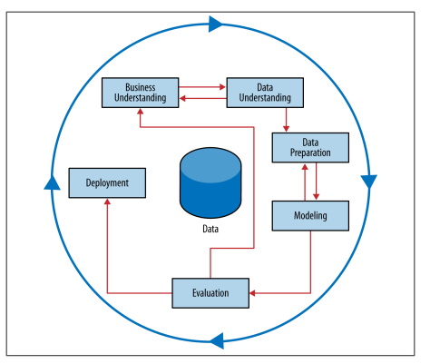
Business Understanding
Business understanding is a process of understanding how our data science project affects the business; this means we need to gain as much information about the business as possible to build our data science project. In real business, we could always discuss with the business user to gain a better insight.

Slide 19
Business Understanding
Business Understanding is a critical stage in the data science process that involves gaining a deep understanding of the problem domain and business requirements. It involves
  understanding the business problem domain,
  studying the business processes involved,
  defining the problem statement, and
  specifying the objectives of the analysis.

Slide 20

Business Understanding cntd…
Let’s try to understand this considering an example / case study.
Case Study:
A retail company wants to increase its sales because sales are the main source of income for the business. However, sales do not increase on their own; they are influenced by many factors such as product prices, discounts, store location, customer demand, seasons, and promotions. To understand what really affects sales, the company collects past sales data and related information. It shares this data with a data science analyst to study it carefully. The company wants to understand, using the data, how it can improve its sales.

Slide 21
Understand Problem Domain
The first step in the Business Understanding stage is to gain a clear understanding of the business problem and the domain in which it exists.
In this case study, we are dealing with a retail company that wants to improve its sales.
We need to understand the retail industry, this may include
  the products that the company sells, and
  the customers that it serves.
This can involve conducting research, reviewing industry reports, and interviewing stakeholders to gain a clear understanding of the business requirements.

Slide 22
Study the Business Processes Involved
The next step is to study the business processes involved in the sales process.
This can include understanding how the products are sourced, how they are marketed and promoted, how they are priced, and how they are sold.
This can also involve reviewing the company's existing sales data to understand the patterns and trends that exist.

Slide 23
Define the Problem Statement
Once we have a clear understanding of the business requirements and the processes involved, we can define the problem statement.
In this case study, the problem statement is-
A retail company wants to improve its sales by identifying the key factors that affect sales.
We need to define the problem statement in a clear and concise manner so that we can develop a plan of action to address it.

Slide 24
Specify the Objectives
The final step in the Business Understanding stage is to specify the objectives of the analysis.
This involves defining the specific outcomes that we want to achieve through our analysis step by step.
In this case study, the objectives might include
  identifying the most profitable products,
  understanding the customer demographics that are most likely to make a purchase, and
  identifying the most effective marketing strategies.

Slide 25
Summary
To summarize, the Business Understanding stage is a critical first step in any data science project. It involves gaining a deep understanding of the problem domain and business requirements, studying the business processes involved, defining the problem statement, and specifying the objectives of the analysis. Through these steps, we can develop a clear plan of action that will guide our analysis and help us to achieve our desired outcomes.

Slide 26
References
https://datafloq.com/read/data-science-8-powerful-applications/7090
https://www.javatpoint.com/data-science
https://makemeanalyst.com/
Data Science for Business – What you need to know about Data Mining and Data Analytic Thinking by Foster Provost & Tom Fawcett
https://www.tutorialspoint.com/big_data_analytics/big_data_analytics_lifecycle.htm

Slide 27
Practice case study
Case Study:
A bank wants to improve customer satisfaction because satisfied customers are more likely to stay with the bank and use its services regularly. However, customer loyalty does not develop automatically; it is influenced by many factors such as quality of service, response time, interest rates, digital banking experience, staff behavior, and trust. To understand what really influences customer loyalty, the bank collects past customer data and feedback. It shares this data with a data science analyst to study it carefully. Using the insights from the data, the bank wants to identify the key factors that influence customer loyalty and take steps to improve customer satisfaction.

Slide 28
Practice case study - Solution
1. Understand Problem Domain / Business Requirements
In this case study, we are dealing with a bank that wants to improve customer satisfaction. We need to understand
  the banking industry,
  the types of products and services that the bank offers, and
  the customers that it serves.
We can conduct research and review industry reports to gain a clear understanding of the business requirements.

Slide 29
Study the Business Processes Involved
The next step is to study the business processes involved in the banking industry. This can include understanding
  how the bank acquires customers,
  how it processes transactions,
  how it manages customer accounts, and
  how it offers customer service.
This can also involve reviewing the bank's existing customer data to understand the patterns and trends that exist.

Slide 30
Define the Problem Statement
In this case study, the problem statement is –
A bank wants to improve customer satisfaction by identifying the factors that influence customer loyalty.

Slide 31
Specify the Objectives
In this case study, the objectives might include
  identifying the most important factors that influence customer loyalty,
  understanding the customer demographics that are most loyal, and
  identifying the most effective customer service strategies.

Slide 32
Home work
Students are encouraged to search more case studies and break it down into the four steps to improve their clarity on how understanding the business can improve the quality of a solution

